Slide 1

Code Refactoring and Bug Fixing

Slide 2
About me
My name is Magbuwe Vera Ogheneovo
I am a Chemical Engineering Student at the University of Benin, Edo State, Nigeria and I am currently doing my undergraduate internship I have always loved Tech and my interest as always been machine learning / data science
Linkedin: https://www.linkedin.com/in/vera-magbuwe-b60a4423b
Github: www.github.com/vera-magbuwe

Slide 3
About the project
Scenario:
A team of enthusiastic data scientists embarked on a mission to develop a Note Taking Application using Python, Flask, and HTML. However, their lack of experience in backend development has led to challenges in making the application fully functional. Recognizing your proficiency in backend development, you have been tasked with fixing the broken code and ensuring the application works seamlessly.
Task:
Refactor the existing codebase and ensure the proper functioning of the Note Taking Application. Document all identified bugs during the debugging process. Remember, the task is not about recreating the app from scratch. Your goal is to fix the already existing codebase and make the application work as intended.

Slide 4
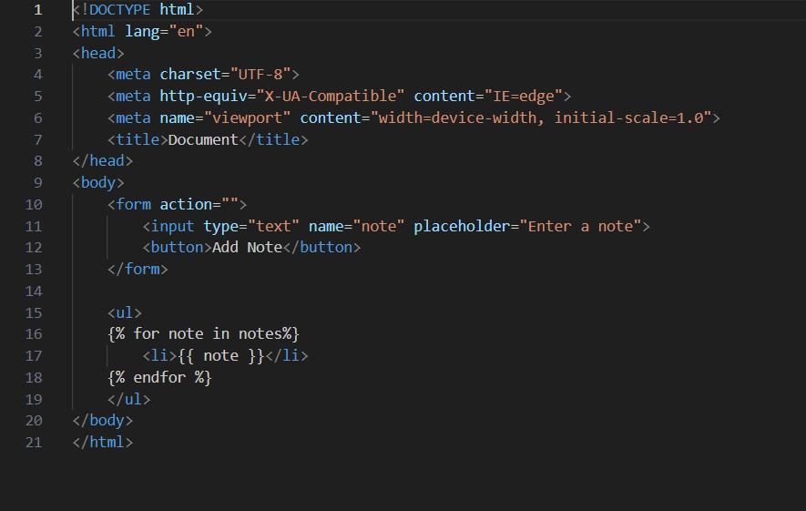
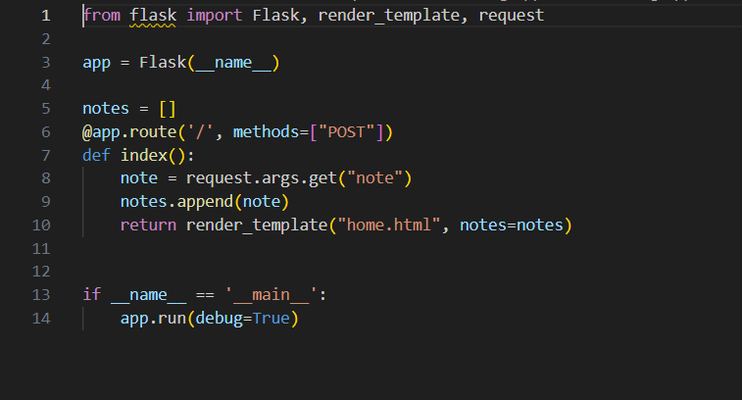
Initial code
HTML
PYTHON

Slide 5
Steps
Created a virtual environment
Installed flask

Slide 6
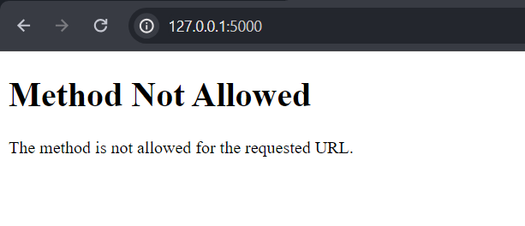
Notes
Added the get method to app.route(‘\’) to prevent this error
Added the Post method to the html form to prevent this error

Slide 7
Notes
Changed the args to form in the request method because we are getting our parameters from a form
Added some extra stylings for the app

Slide 8
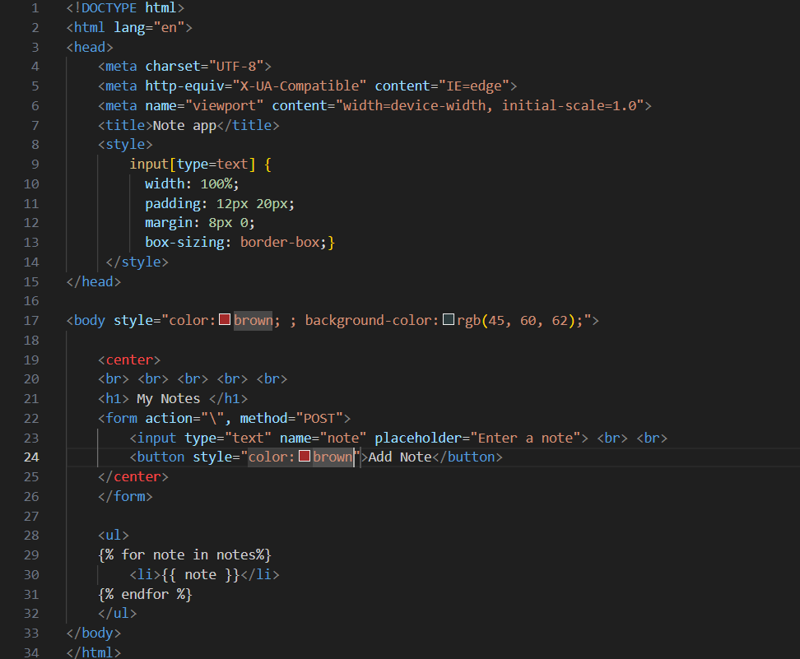
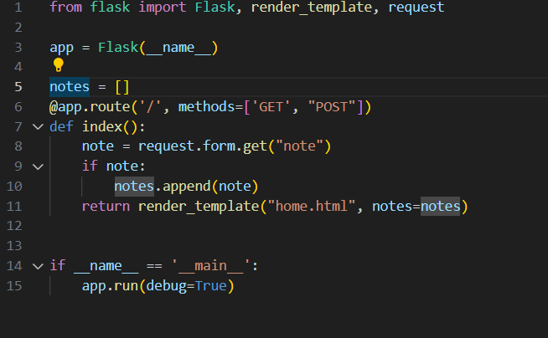
Initial code
HTML
PYTHON

Slide 9
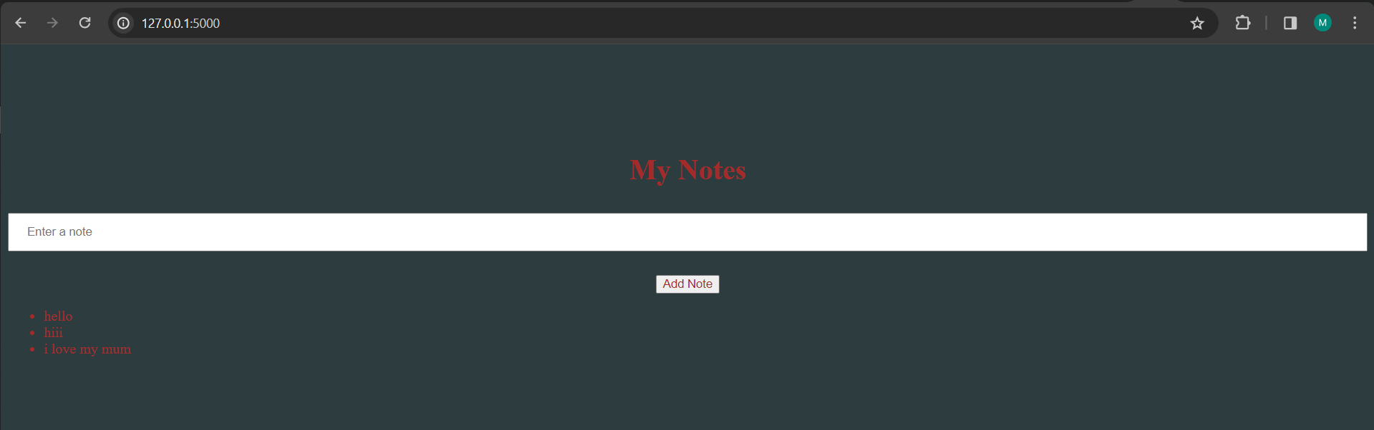
Final Output

Slide 10

THANK YOU

